Slide 1


Oral Communication Skills B
(CELEN082)
Lesson 5.2

Slide 2
Lesson aims and objectives
Increase your awareness of when and how to refer to sources of information in academic presentations. Develop a set of guidelines to help you make decisions about when and how to refer to sources in your own presentation.

Slide 3

Getting started

Slide 4

Getting started
In your group, use your existing knowledge of referring to sources to complete the statements below with the words provided.
When I use information from a source in an academic presentation, I… | always | sometimes | never
______ need to say the name of the author.
______ need to say the year the source was published.
______ need to provide a citation on my slides for the sources where I got information from.
______ need to include the source in my reference list.
Everyone in your group must agree on the same answers. Persuade each other if you have different opinions.

Slide 5
Referring to sources in presentations

Slide 6
Referring to sources in presentations
Listen to four extracts of an experienced speaker presenting information. Match each extract to the type of information below.
a real-life example
findings from a research study
a reason
a definition
EXTRACT 3
EXTRACT 1
EXTRACT 2
EXTRACT 2
EXTRACT 4
EXTRACT 3
EXTRACT 1
EXTRACT 4

Slide 7
Referring to sources in presentations
Listen to the first two extracts again, and fill in the gaps in the transcript in the OCSb Workbook as you listen.
EXTRACT 1
OK, so, first, what is obesity and why is it a problem? Well, the ________________________________ it as “abnormal or excessive fat accumulation that may impair health.”
EXTRACT 2
In addition to calories consumed, sedentary lifestyles exacerbate the situation. This is backed up by a __________ from the _____________________________ that 25% of UK adults do not meet the recommended levels of physical activity, and this swells obesity rates.
World Health Organization defines
2021 study
World Obesity Federation showing

Slide 8
Referring to sources: Critical thinking
When deciding how to refer to sources in presentations, experienced speakers engage in a complex thought process. Analyse the six thoughts below and match them to the four presentation extracts in the OCSb Workbook.
The author created this information, so it’s important to say the name of the author.
The audience need to know the year of publication to fully understand the information, so it’s important to say the year.
I have provided a citation on the slide and the audience can find the source using the citation and the reference list if they want to check the information.
A
C
E
This information is a fact. The author did not create it, so it’s not important to say the name of the author.
Details about timing are included in the description of the information itself so it’s not important to say the year of publication.
I’m giving my own opinion. It’s also a pretty general idea that most educated people could form using common sense, so I don’t need a citation.
B
D
F

Slide 9
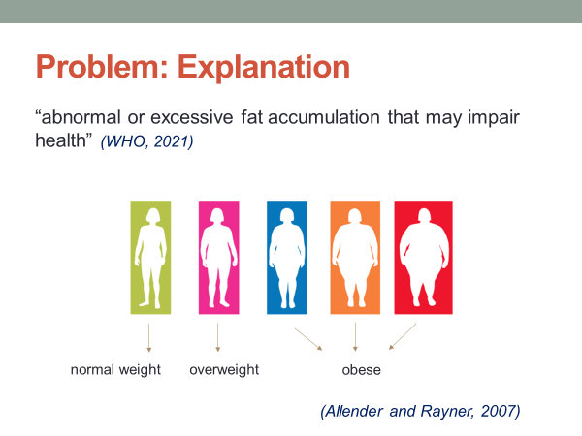
Referring to sources: Critical thinking
EXTRACT 1
OK, so, first, what is obesity and why is it a problem? Well, the World Health Organization defines it as “abnormal or excessive fat accumulation that may impair health.”
The author created this information, so it’s important to say the name of the author.
I have provided a citation on the slide and the audience can find the source using the citation and the reference list if they want to check the information.
A
E

Slide 10
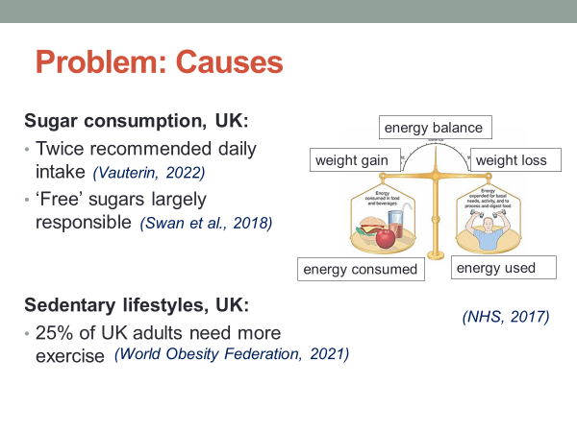
Referring to sources: Critical thinking
EXTRACT 2
In addition to calories consumed, sedentary lifestyles exacerbate the situation. This is backed up by a 2021 study from the World Obesity Federation showing that 25% of UK adults do not meet the recommended levels of physical activity, and this swells obesity rates.
The author created this information, so it’s important to say the name of the author.
The audience need to know the year of publication to fully understand the information, so it’s important to say the year.
I have provided a citation on the slide and the audience can find the source using the citation and the reference list if they want to check the information.
A
C
E

Slide 11
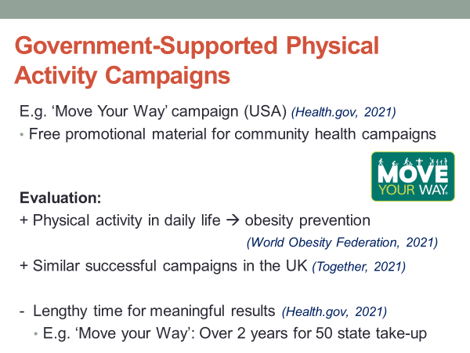
Referring to sources: Critical thinking
EXTRACT 3
OK, so let’s think about how these campaigns would operate in practice. Well, an initiative called the ‘Move Your Way’ campaign launched in 2018 in the United States provides a good model. Through this campaign, the federal government provided free promotional material - posters, pamphlets and videos - to service providers such as schools to run health campaigns in their local area.
This information is a fact. The author did not create it, so it’s not important to say the name of the author.
Details about timing are included in the description of the information itself so it’s not important to say the year of publication.
I have provided a citation on the slide and the audience can find the source using the citation and the reference list if they want to check the information.
B
D
E

Slide 12
Referring to sources: Critical thinking
EXTRACT 4
However, as with my first solution, there’re potential issues here, too. In particular, it’s likely that it would take some time to achieve meaningful results. We’d need to create the educational resources, build the website and then publicize the campaign.
I’m giving my own opinion. It’s also a pretty general idea that most educated people could form using common sense, so I don’t need a citation.
F

Slide 13
Referring to sources: Discussion
Using what you have learnt today, consider whether you need to change your answers from the beginning of the lesson.
When I use information from a source in an academic presentation, I… | always | sometimes | never
______ need to say the name of the author.
______ need to say the year the source was published.
______ need to provide a citation on my slides for the sources where I got information from.
______ need to include the source in my reference list.
✓
✓
✓
✓
If your answer is ‘sometimes’, list the times when you need to do it.

Slide 14

Referring to sources: Citations on slides
Identify two types of information that need to be included in a citation.
The author’s family name (or the name of the organization).
The year of publication.
Is this the same as RWAC/ ESAC?

Slide 15
Independent practice

Slide 16
Independent practice
Using the slide from your problem section that you created for homework, complete the tasks below:
Analyse your slide and check whether:
you have used information from sources. If not, do you need to?
you have included citations.
you have written the citations in the correct format.
Practise presenting the information on your slide(s). Consider whether:
you should say the author’s name. Why/ Why not?
you should say the year of publishing. Why/ Why not?

Slide 17
Homework
Due | Task
Lesson 6.1 | Prepare the introduction of your Final Presentation.​ Decide what you will say and practise saying it.​ Create at least two PowerPoint slides for your introduction.​ Bring your slides and script (if you write one) to class.
Lesson 6.2 | Prepare the conclusion of your Final Presentation. Decide what you will say and practise saying it.​ Create at least one PowerPoint slide for your conclusion.​ Bring your slide and script (if you write one) to class.

